Slide 1

🦟
Ensemble ML
for the Prediction of
Artemisinin Resistance
in Malaria

Slide 2
🦟
Machine Learning in the Prediction of Artemisinin Resistance and Diagnostic Test Sensitivity in Malaria

Slide 3


Slide 4

Genetic Capitalism and Stabilizing Selection of Antimicrobial Resistance Genotypes in Escherichia coli
Colby T. Ford, Gabriel Lopez Zenarosa, Kevin Smith,
David Brown, John Williams, and Daniel Janies

Slide 5
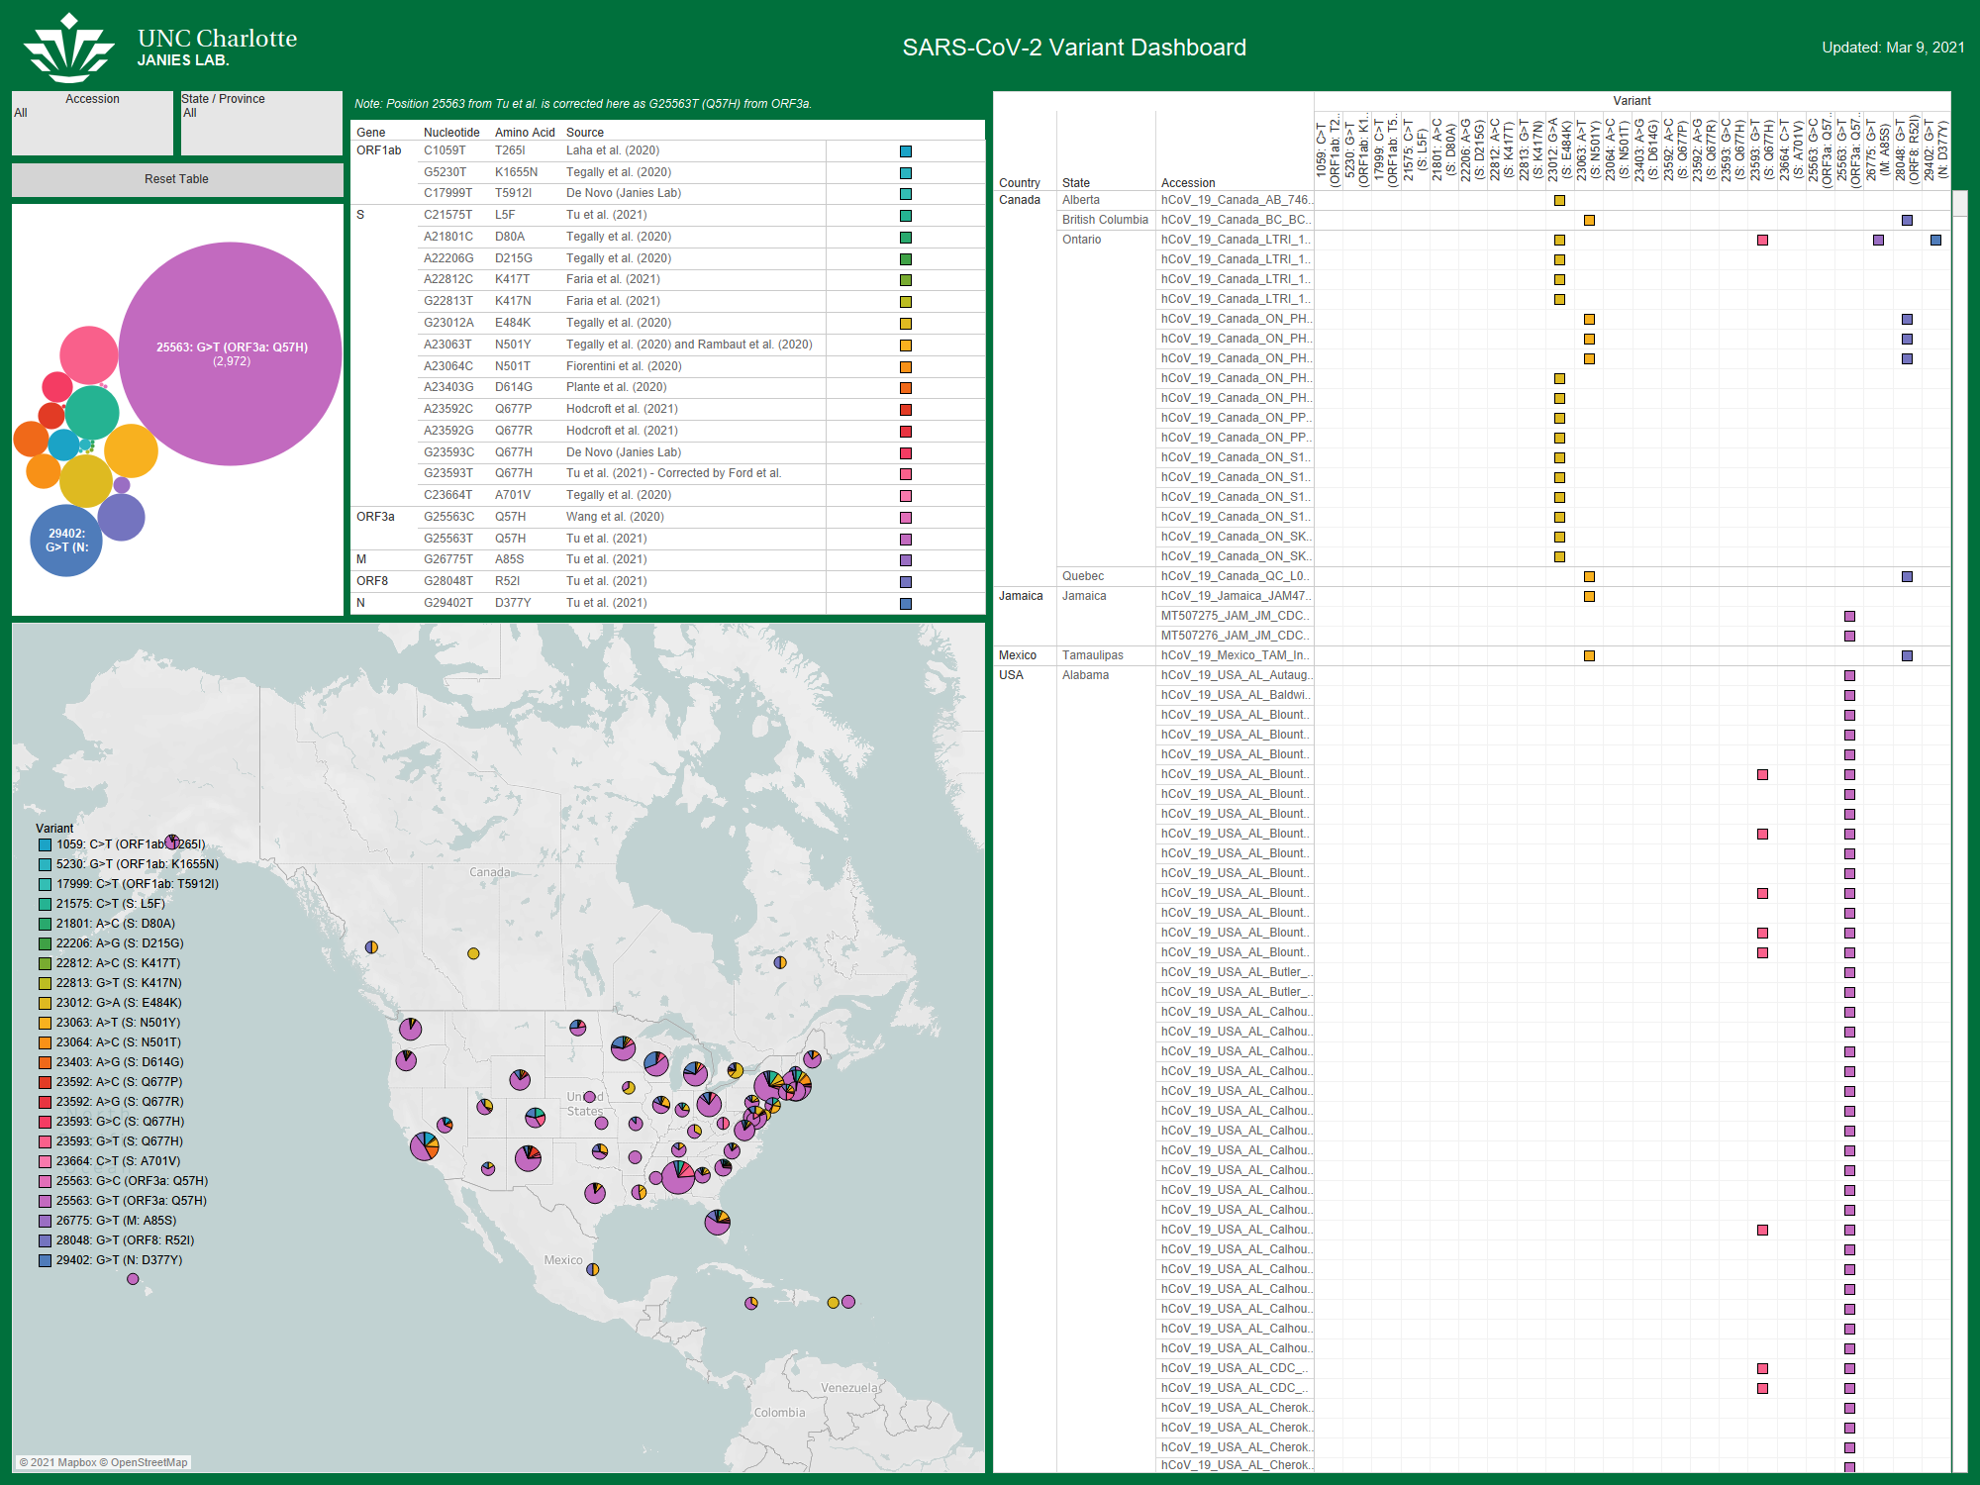
SARS-CoV-2 Variant Tracking

Slide 6

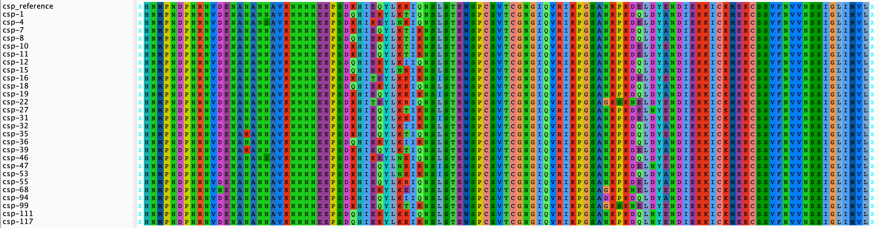
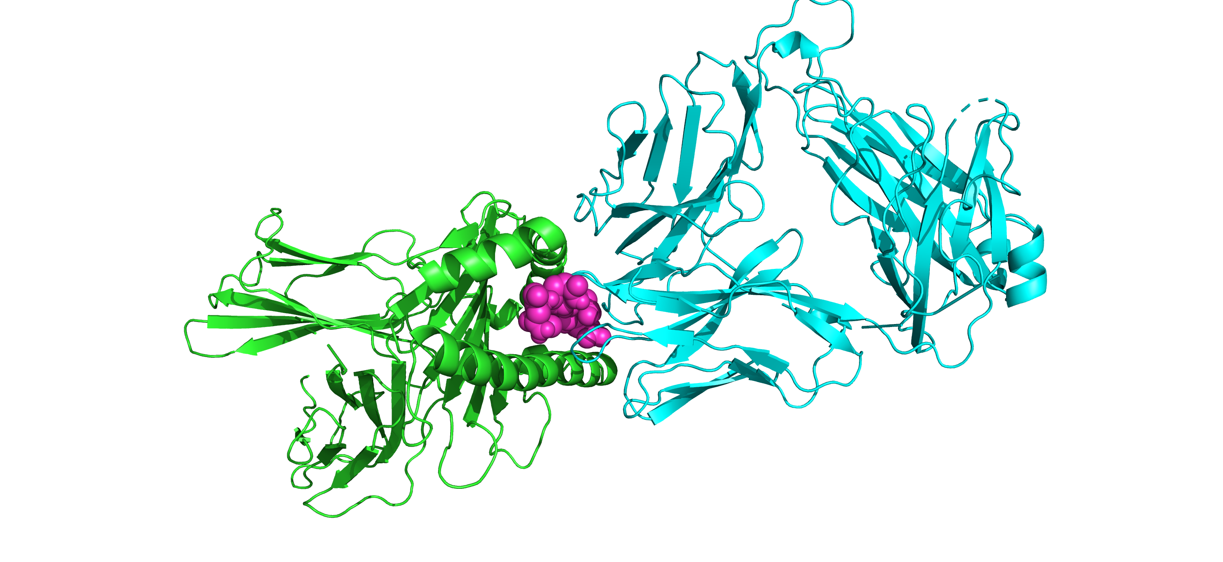
Plasmodium Falciparum Haplotyping and Human Immunological Protein Structure Interaction Analysis

Slide 7



Slide 8

bio-Power BI

Slide 9


Slide 10
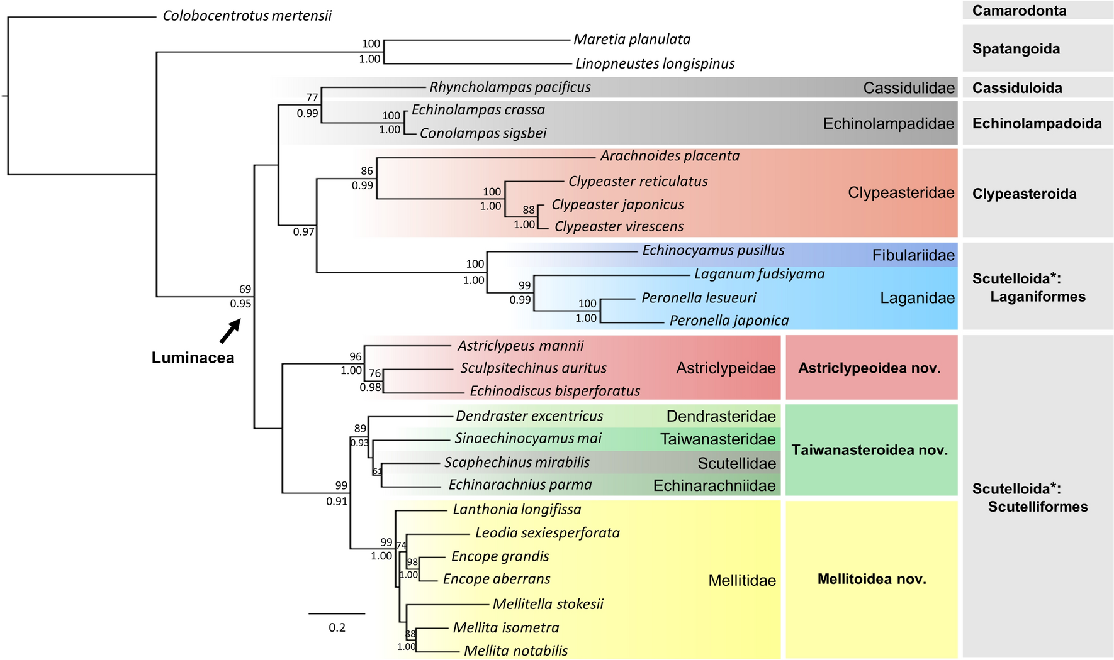

Slide 11
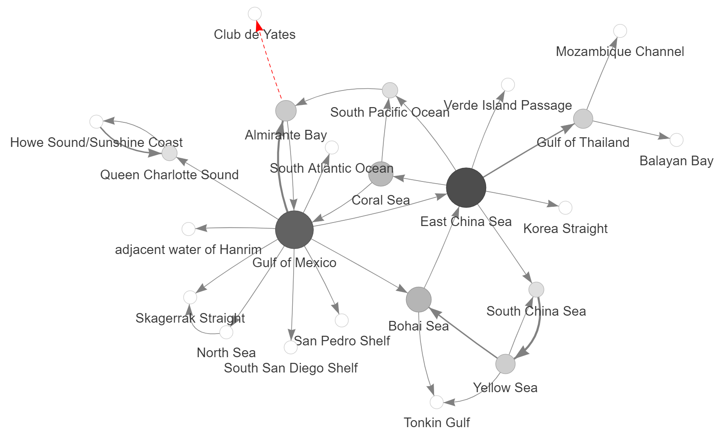

Slide 13
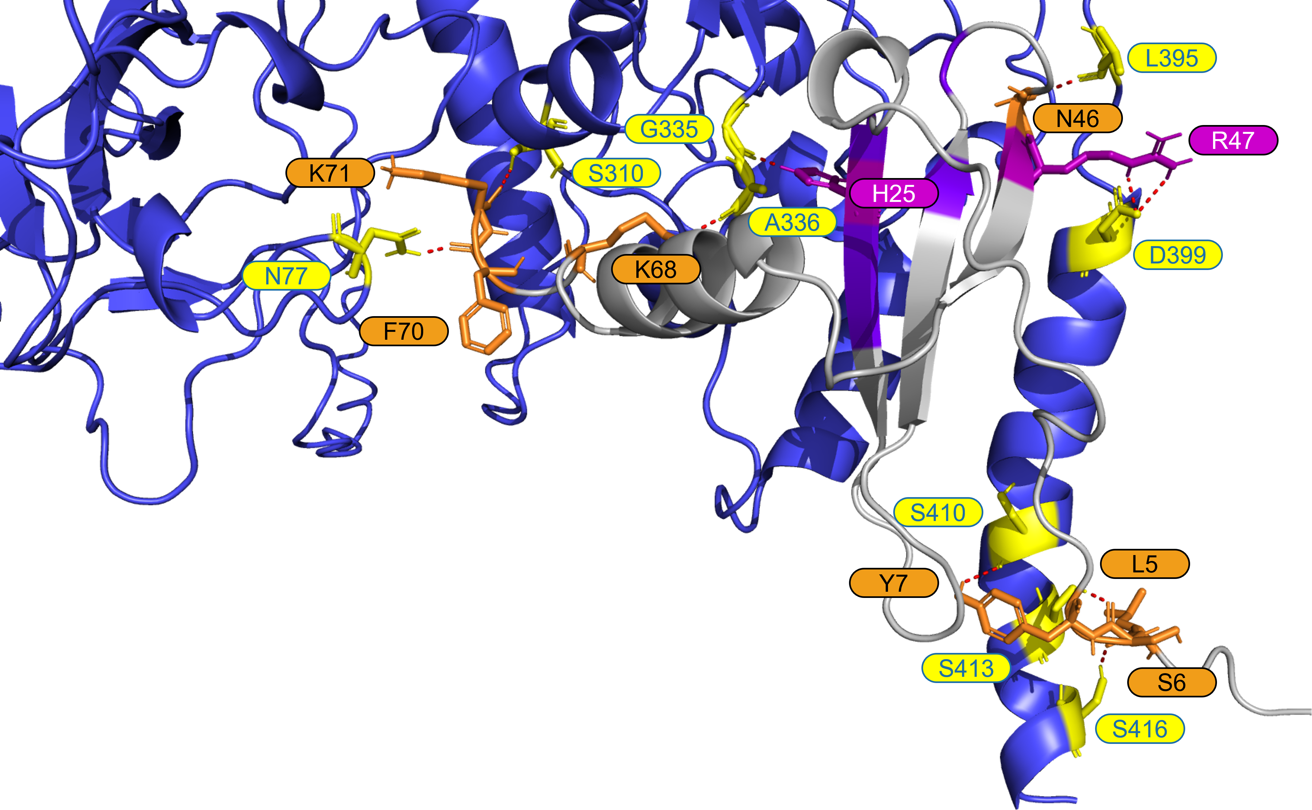
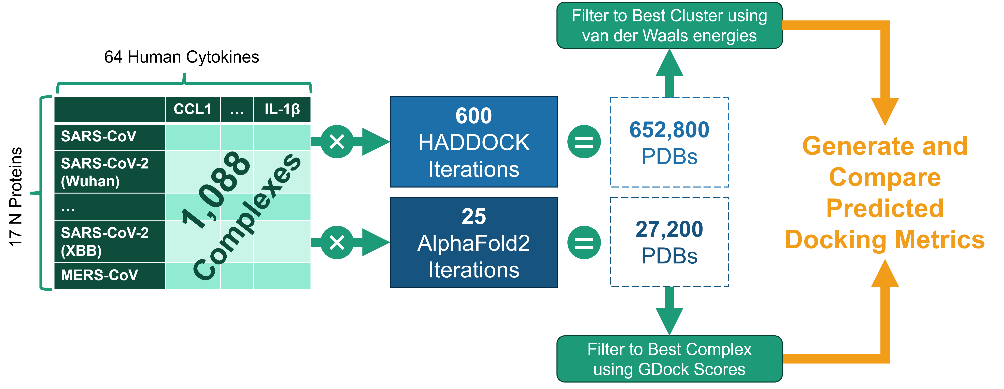

Slide 14
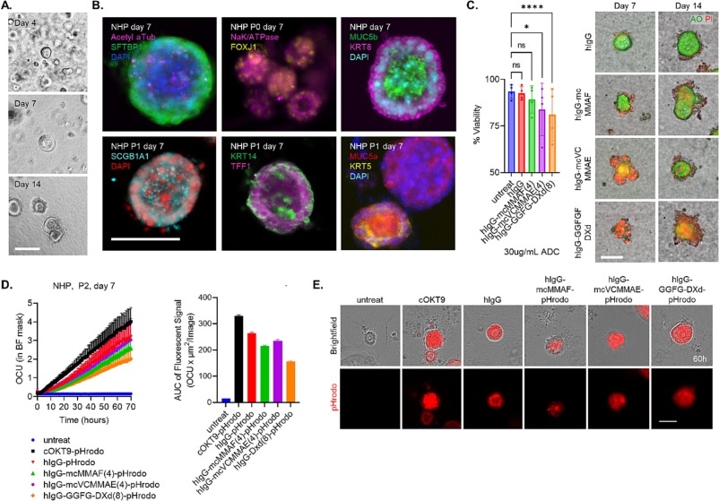

Slide 15
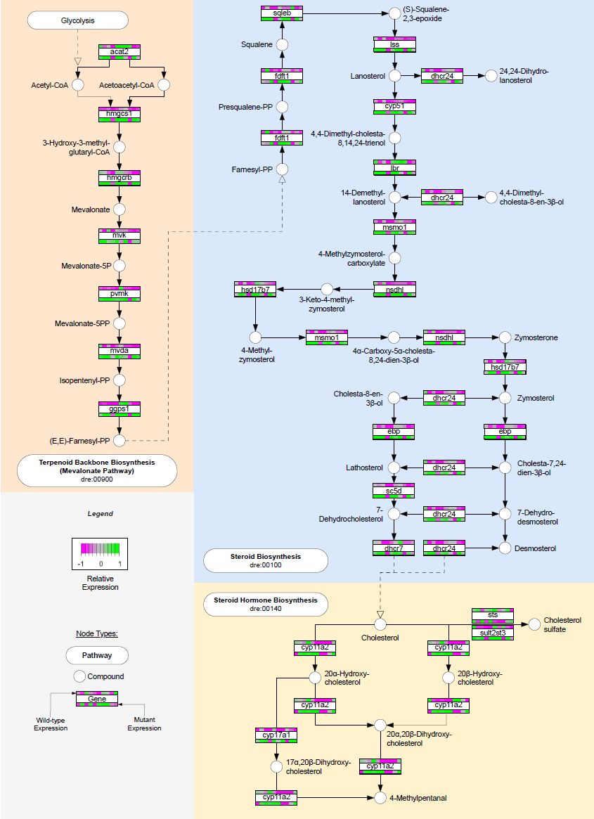
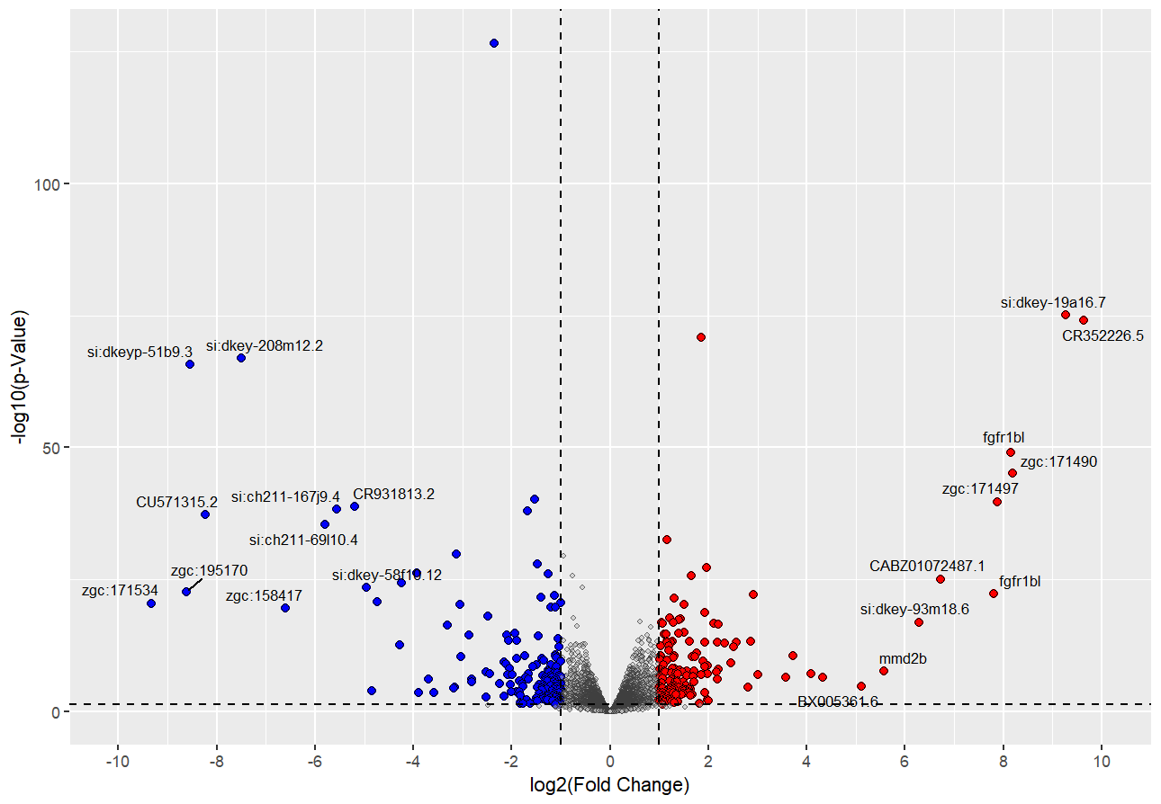
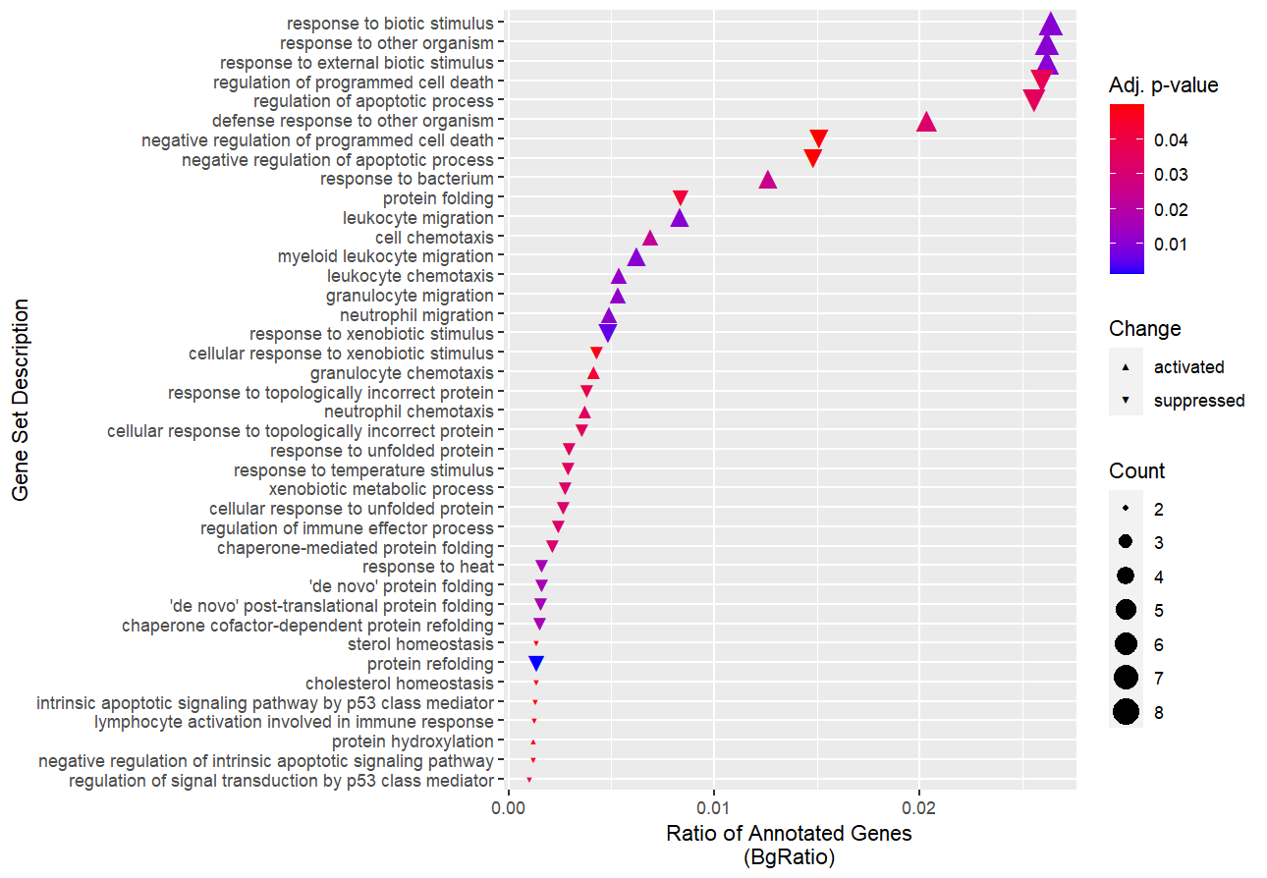

Slide 16
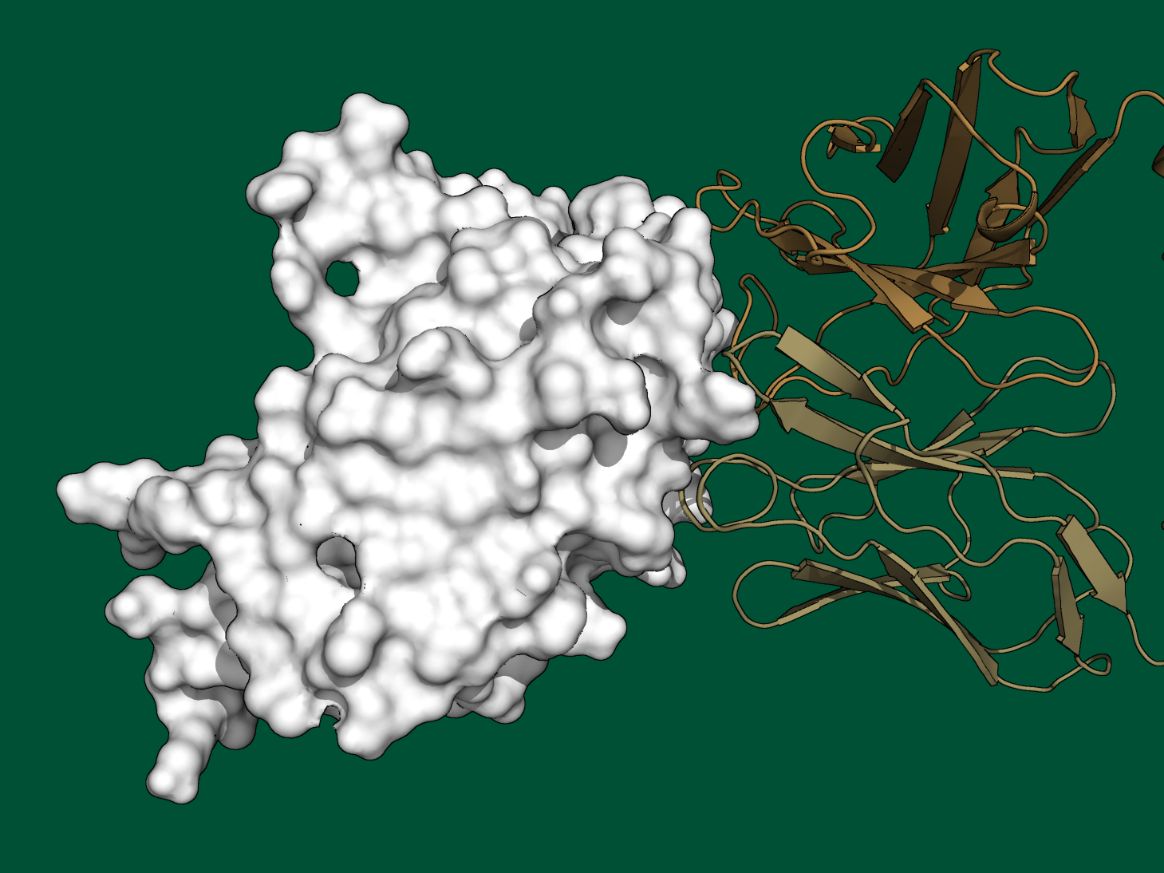

Slide 17
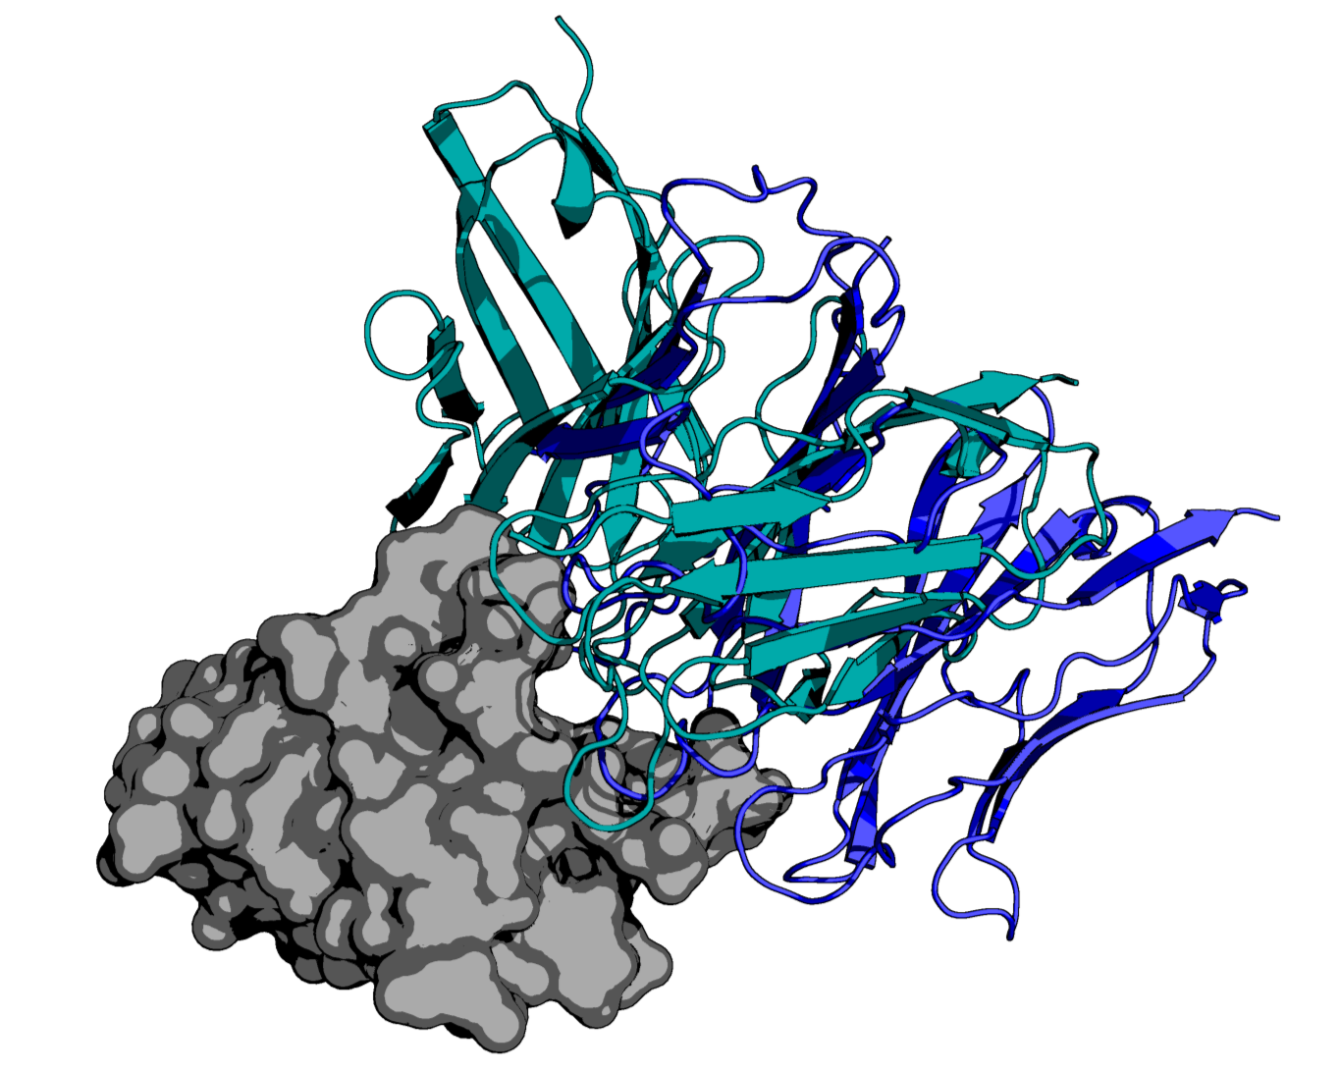

Slide 18
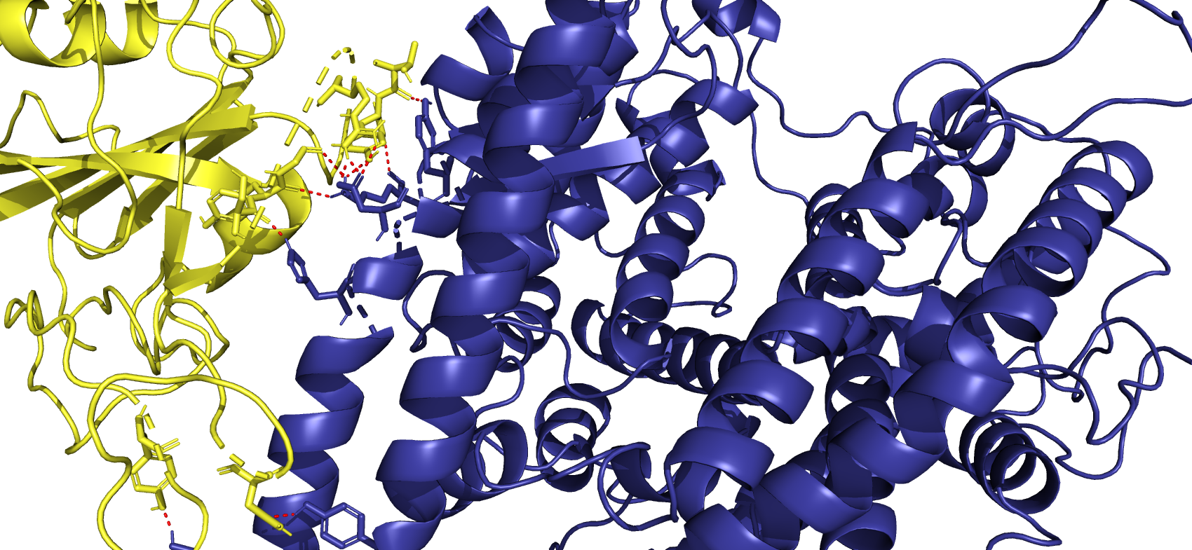
T500
G502
G496
R498
Y495
Y501
S494

